Slide 1
Software Engineering
COMP 201
Lecturer: Sebastian Coope
Ashton Building, Room G.18
E-mail: coopes@liverpool.ac.uk
COMP 201 web-page:
http://www.csc.liv.ac.uk/~coopes/comp201
Lecture 2 – Software Processes

Slide 2
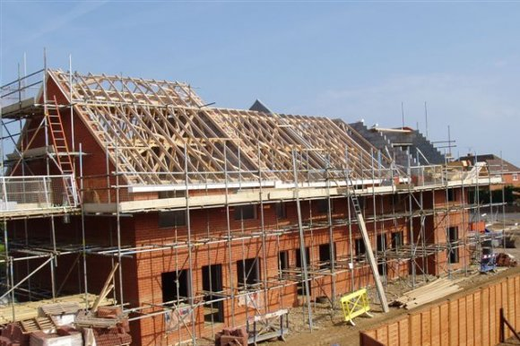
Processes (building a house)

Slide 3
Tasks
What to build?
Where to build?
How much money?
Get the money
Design the build (Detailed plans, timescales etc.)
Get permissions?
Start with foundations
Build up from foundations
Fully test everything
When basic structure complete, make sure it is looks right
Show to customer
Re-adjust to customers feedback

Slide 4
Questions?
Does the previous list apply to Software?

Slide 5
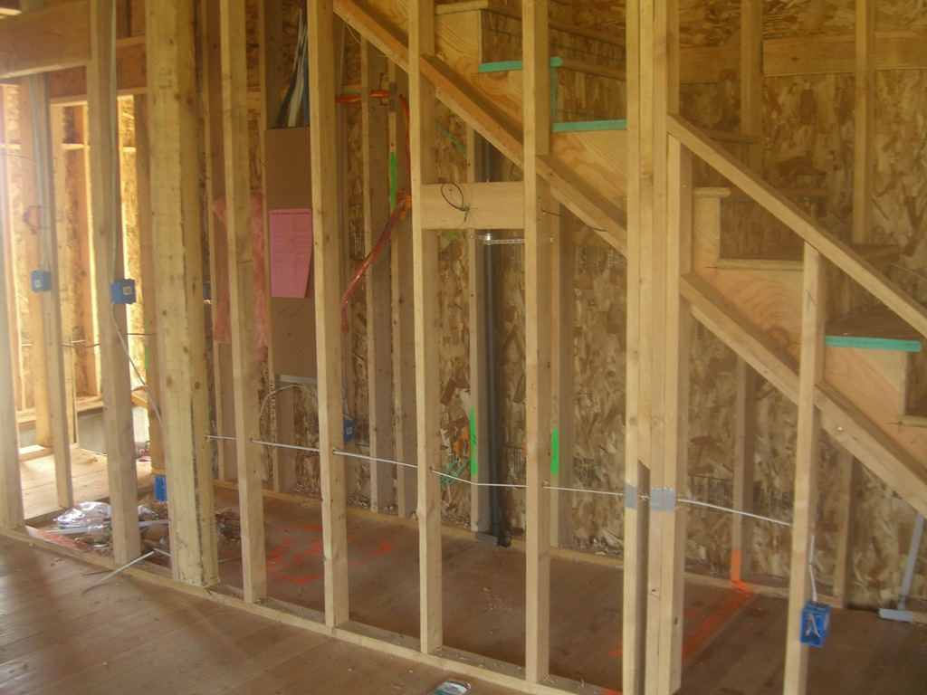
Task order (early fix is easy)

Slide 6
What is a Process … ?
When we provide a service or create a product we always follow a sequence of steps to accomplish a set of tasks
  You do not usually
    put up the drywall before the wiring for a house is installed or
    bake a cake before all the ingredients are mixed together
We can think of a series of activities as a process
During this lecture we shall see some examples of software development processes that are used to ensure software is developed in a systematic way using tried and tested techniques

Slide 7
What is a Process … ?
Any process has the following characteristics
  It prescribes all of the major activities
  It uses resources and produces intermediate and final products
  It may include sub-processes and has entry and exit criteria
  The activities are organized in a sequence
  Constraints or controls may apply to activities
  (budget constraints, availability of resources , etc.)

Slide 8
Process
Building development
Architect
Design
house
Get
Planning permission
Secure
funding
(re)Draw plans
(re)Specify build
Site survey
Plans/
specifications

Slide 9
Software Processes
When the process involves the building of some product we refer to the process as a life cycle
Software development process – software life cycle
Coherent sets of activities for
  Specifying,
  Designing,
  Implementing and
  Testing software systems

Slide 10
Processes and software
Software (unlike buildings/bridges etc.)
  Can be changed at anytime
  Is often required to change often after construction
Benefits
  Software can be improved almost without limit
Leading to problems
  Software often gets faults as it evolves
  Software cost is hard to manage
  Problems with user’s experience and expectations

Slide 11
Software Process Models
The Waterfall Model (classic engineering, example bridge building)
  Separate and distinct phases of specification and development
Evolutionary Development (more like product engineering)
  Specification and development are interleaved
Agile and Scrum
  Used widely in industry today

Slide 12
Waterfall Model
The drawback of the waterfall model is the difficulty of accommodating change after the process is underway

Slide 13
Waterfall Model Problems
Inflexible partitioning of the project into distinct stages
This makes it difficult to respond to changing customer requirements
Therefore, this model is only appropriate when the (final) requirements are well-understood (rare in software)
Waterfall model describes a process of stepwise refinement
  Based on hardware engineering models
  Widely used in military and aerospace industries

Slide 14
Reality check!
Practically no one in industry follows the waterfall method as shown exactly here to produce software
Why bother, then?
  Each stage is an important step in software development
  It’s easy to remember
  The sequence is important
    Spec. before Design
    Design before coding etc.
  Many industry practises could do with improvement!

Slide 15
Evolutionary Development
Rather than using the waterfall model we may use evolutionary development which is based upon the idea of developing an initial implementation , exposing it to the user and refining it based upon their response.
Exploratory development
  Objective is to work with customers and to evolve a final system from an initial outline specification.
  Should start with well-understood requirements.
  The system evolves by adding new features as they are proposed by customer.

Slide 16
Evolutionary Development

Slide 17
Evolutionary Development
Problems
  Lack of process visibility
  Systems are sometimes poorly structured
Applicability
  All types of system but rare in safety critical

Slide 18
Reality check
In reality all modern development has a degree of evolutionary development BUT is hybrid (see SCRUM later)
Sometimes the specification is mostly completed at the start and then added to
The evolution cycles pre-determined
  100 functions
  In phase 1 develop functions 1-30
  In phase 2 develop functions 31-80
  In phase 3 develop functions 81-100

Slide 19
Agile development
Lightweight approach to software development
Example include Scrum and XP
Focused on
  Code development as code activity
  Test driven development (tests developed before code)
  Often use pair programming
  Iterative development
  Self organised teams

Slide 20
Incremental Development
(Scrum)
Rather than deliver the system as a single delivery, the development and delivery is broken down into increments (SCRUM sprints) with each increment delivering part of the required functionality
User requirements are prioritised and the highest priority requirements are included in early increments
Once the development of an increment is started, the requirements are frozen though requirements for later increments can continue to evolve

Slide 21
Incremental Development Advantages
Customer value can be delivered with each increment so system functionality is available earlier
Early increments act as a prototype to help elicit requirements for later increments
Lower risk of overall project failure
The highest priority system services tend to receive the most testing

Slide 22
In Reality
Most software processes involve
  Prototyping
  Iterative building
Why
  It reduces risk of making the wrong product
  It allows the software to undergo more testing
  It produces working product as we go along, so less chance of inventory loss

Slide 23
Process is context dependent
Nuclear power station/air traffic control
  Highly formalised processes
  Detailed testing specifications
Web development for small website
  Prototyping
Web development for large website
  SCRUM development, storyboarding

Slide 24
Final question
The specification is by a long margin
  The MOST critical phase of any software engineering project
Why?

Slide 25
Lecture Key Points
Software processes are the activities involved in producing and evolving a software system. They are represented in a software process model
General activities are specification, design and implementation, validation and evolution
Generic process models describe the organisation of software processes
Iterative process models describe the software process as a cycle of activities

